Slide 1
Student Name: Deepak Goyal
Course Name: LJMU Masters in ML and AI- June 2025
Student ID: 1180979
Thesis Topic: Protecting PII Data in LLM’s by using Encoding/ introducing noise at client end
Thesis Supervisor: Sushrut Shinde
Notes:
Good morning. My thesis addresses the critical challenge of protecting Personally Identifiable Information, or PII, in the rapidly expanding use of Large Language Models. The goal is to develop a robust, client-side privacy solution that balances security with the necessity for real-time performance.

Slide 2



Motivation & Stakes
$4.88 M average cost per Incident in corporate settings.
High Cost of Breaches: The global average cost of a data breach hit a record peak of 4.88 million in 2025.
Growing Privacy Concern: Anyone chatting with AI chatbots is skeptical about potential information leakage or misuse.
LLMs are "highly prone to retaining and copying PII from the input when prompted" (up to 57.4% leakage in studies)
Regulatory Pressure: AI systems must incorporate robust privacy mechanisms due to frameworks like the EU’s AI Act, US Executive Order, GDPR, and HIPAA.
Notes:
Let me quickly start with what’s my motivation in picking this topic, I work for financial institution where protecting customer data specifically PII data is of utmost importance. PII (Personally Identifiable Information) refers to any data that can directly or indirectly identify an individual.
In today’s world our reliance on Digital services is increasing day by day which is good but it comes at a price, cyber security attacks. do you know when you interact with LLM, it can retain your PII data and can leak your data in more than 50% of the cases. Alarming right?
As per research done by IBM avg cost of one data breach in corporate setting is wooping 4.88M per incident, wow significantly high.
The financial and healthcare sectors are under acute pressure from the regulatory bodies like GDPR, HIPPA threat, reinforcing the need for advanced defense mechanisms.
Regulatory frameworks make developing practical, efficient, local privacy solutions paramount.

Slide 3
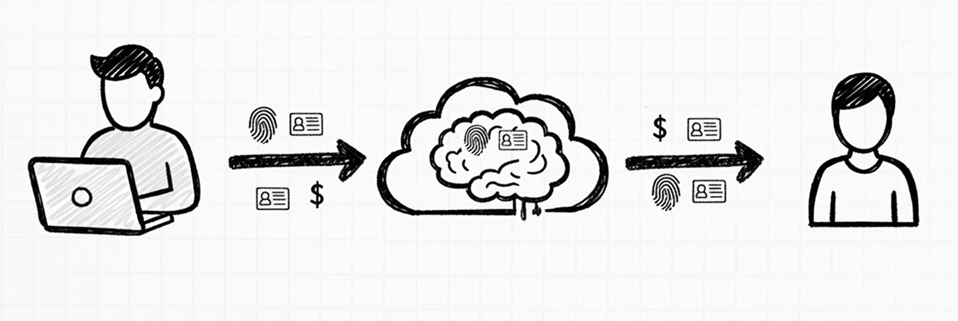
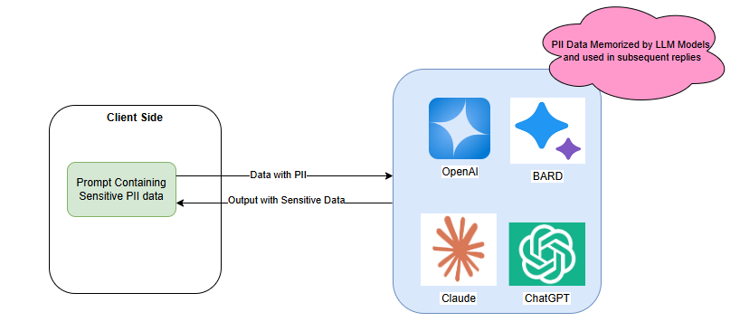
Problem Statement
User 1
Figure: 1
User 2
LLMs Memorize and Leak User Input User prompts containing PII are transmitted unprotected to server-side LLMs.
Exam question is how we protect the PII data from even leaving the User 1 machine i.e. Protecting the PII data at client side.
Figure: 2
Notes:
Refer to Fig: 1 on this slide, Let’s assume a scenario, where User 1 put a prompt in LLM chatbot that contains PII data, with LLM having tendency to memorize PII data, there are high changes when User 2 asks something related to User 1, LLM can be tricked to reveal PII data of User 1
So Problem Statement is how do we protect PII data so that it don’t even leave User 1 machine

Slide 4
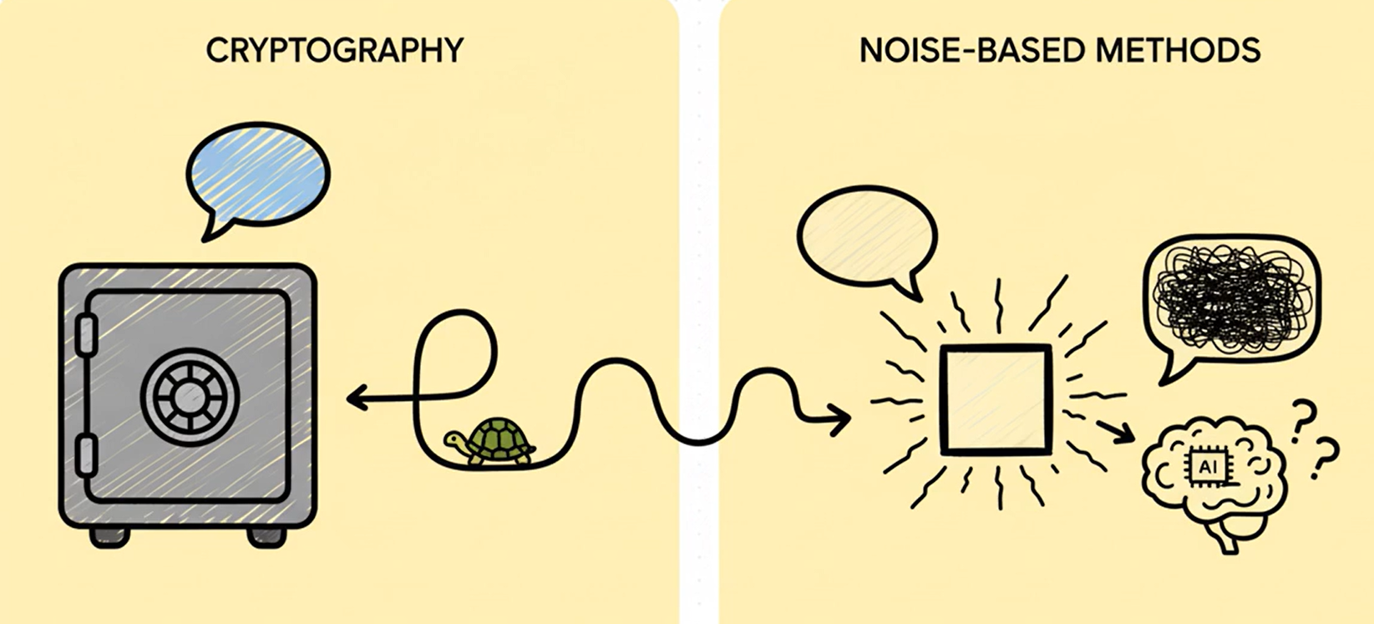
Existing Limitations and Research Gap
Figure: 3
Cryptographic Approaches (HE, SMPC):Offer strong privacy but impose significant computational overhead and latency (e.g., 1000x slower).
Perturbation Methods (DP): Improve scalability but struggle with the privacy-utility trade-off, often leading to diminished accuracy and unreliable outputs.
SnD Framework: Lacks way to identify PII data effectively, risking leakage of identifiable entities.
Gap: Need for a robust, practical, and efficient client-side solution that guarantees privacy (PII data) and balances model performance.
Notes:
It’s not that this problem has not been researched on earlier, There are numerous number of existing papers that tries to solve this problem but Current solutions force a painful trade-off between accuracy and performance. Cryptographic methods like Homomorphic Encryption (HE) offer strong guarantees but are highly computationally heavy, thus, restricting their use in real-time applications.
On the other hand, Perturbation methods like Differential Privacy degrades output quality due to excessive noise they add.
Existing hybrid frameworks like Split-N-Denoise does a good job to an extent but still lack integrated Named Entity Recognition, meaning identifiable entities can pass through unprotected.
This research directly addresses this critical gap by providing a way to Identify PII data and provides different methods to balance performance and utility.

Slide 5
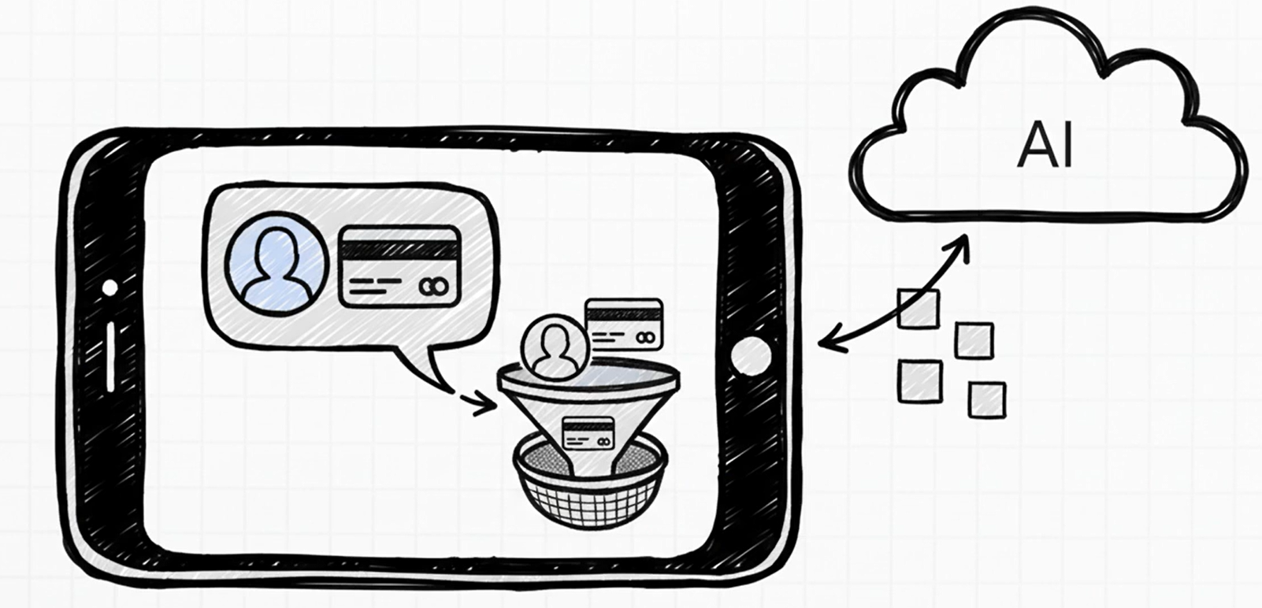
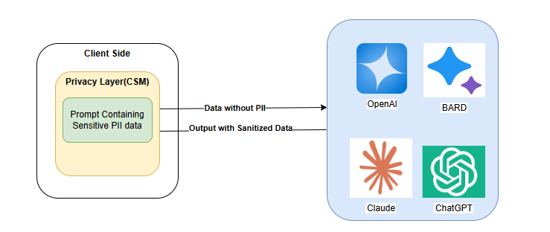
Introducing CSM(Clean Split Model)
CleanSplit Model (CSM): A novel privacy-preserving inference framework.
Aim: Develop a novel framework that helps to pick right methodology for efficiently protecting PII in Client side chatbots(LLM inference).
Objective: Study existing methods and develop a framework to Optimize the trade-off between privacy preservation and computational utility.
Mechanism: Deploys a lightweight token representation layer on the client side. Uses NER to detect and replace sensitive entities prior to server interaction
Figure: 5
Figure: 4
Notes:
My paper proposes solution to the problem described in previous slides is CleanSplit Model, or CSM. The core aim of CSM is to provide a framework to protect clients PII data and empower to chose right methodology to balance protection with performance. As you can see in Figure 4 CSM gives you a Privacy layer on client side so that it ensures that raw PII is never transmitted to the LLM servers. This is achieved by incorporating a Named Entity Recognition (NER)-driven approach for detection and synthetic replacement. Explained in upcoming slides.
The challenge addressed by the CSM framework is analogous to a postal worker sorting mail inside your house before it leaves, rather than trusting the entire postal system.

Slide 6
Research Objectives & Alignment
Research Question | Description
RQ1 | Efficiency: What are the problems in existing PII protection mechanisms and how efficiently can NER models be deployed client-side while minimizing overhead/latency?
RQ2 | Impact: How does PII substitution influence the accuracy, coherence, and semantic integrity of responses?
RQ3 | Balancing: How can privacy be safeguarded while retaining contextual continuity in multi-turn conversations?
Notes:
My research was structured around three fundamental questions. First, Find out the problems in existing PII protection mechanisms and how efficiently can NER be deployed at the client-side? Second, how does PII replacement affect response quality? And third, how to balance privacy with contextual continuity in complex conversations? These Research Questions align precisely with our objectives: reviewing existing methods, developing the client-side NER replacement system, and benchmarking the architecture against utility and performance.

Slide 7
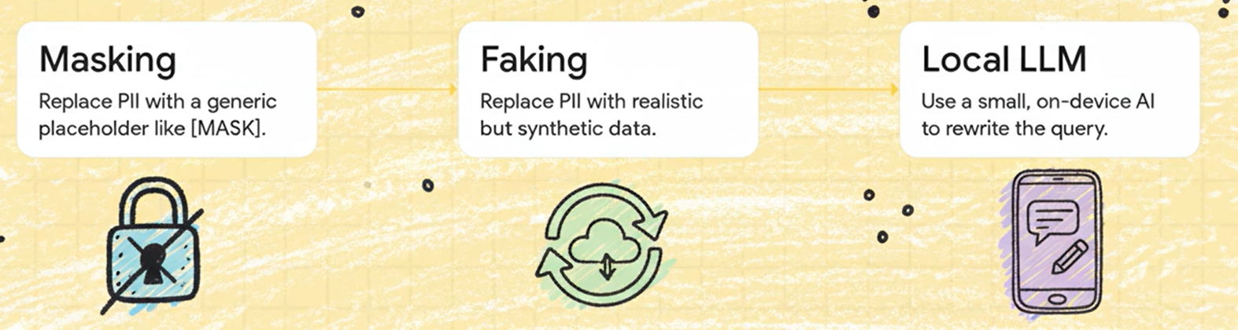
Methodology: Experimental Conditions
Experiments | Description
E1 (Baseline) | Raw input, PII sent as is (Iraw​).
E2 (Masking) | NER, PII replaced with "XXXX" (Imasked​).
E3 (Faking) | NER, PII replaced with Synthetic/Fake Data (Ifaked​)
E4 (CSM/LLM) | Local LLM (Ollama) for Context-Aware Abstraction (Iabstracted​)
Figure: 6
Notes:
This slide explains the various experimental conditions we used
Experiment 1 served as the baseline: raw, unaltered PII data is sent directly, Experiment 2 was simple masking, replacing PII entities with "XXXX“
Experiment 3 used NER and Faking, substituting PII with realistic, contextually plausible, synthetic replacements
Experiment 4, uses a local LLM like Ollama to perform intelligent, context-aware abstraction, preserving semantic consistency.

Slide 8
Methodology: Justification of Tools and Metrics
Section | Description
Tool Choice | NER: spaCy (lightweight, CPU-optimized, fully offline). Local LLM: Ollama (on-device execution, low memory overhead, supports quantized models)
Metrics | Privacy: PII Leakage Rate (PLR), Entropy. Utility/Quality: BLEU, ROUGE, Coherence Score, Semantic Similarity. Efficiency: Average Processing Time.
Notes:
This slide justifies the tool choices I made. I selected spaCy for NER over Presidio and Hugging Face transformers because it is lightweight, CPU-optimized, and runs fully offline, meeting our client-side privacy requirement. Ollama was chosen as the local LLM engine for generating replacements because it runs entirely on-device, ensuring no user data leaves the local environment.
I used a multi-dimensional set of metrics like performance, memory, fit for purpose to ensure methodological rigor.
I combined PLR (quantifies PII removal) with ROUGE and Coherence scores (assess content and contextual flow). This holistic view captures the precise privacy-utility and performance trade-off.

Slide 9
Quick Demo
Short Video showing the various techniques used.(Covered in Video presentation)

Slide 10
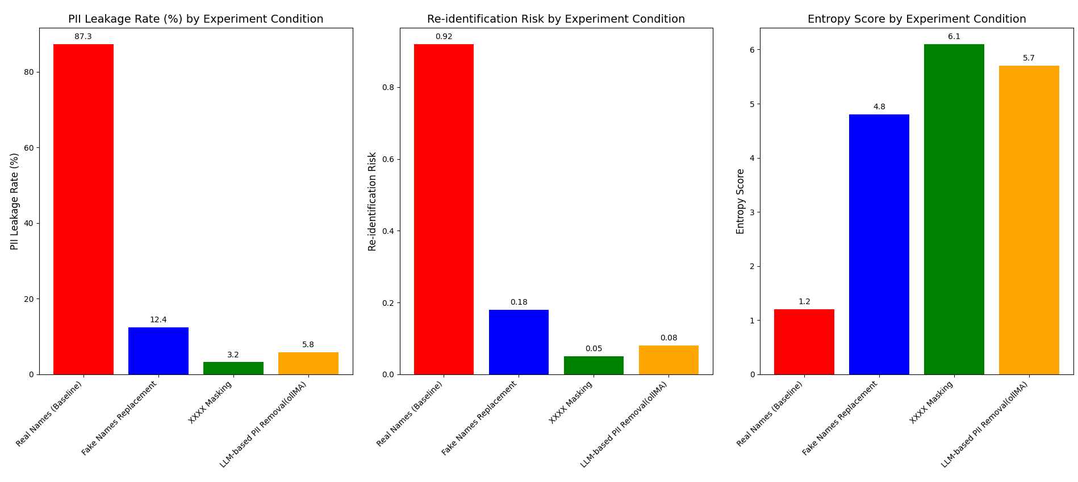
Results and Evaluation : Privacy Effectiveness
Experiment Conditions | PII Leakage Rate | Re-identification Risk | Entropy Score | Outcome
Exp 1: Real Names (Baseline) | 87.3% | 0.92 | 1.2 | PII entities reappearing verbatim in model outputs
Exp 2: Fake Names Replacement | 12.4% | 0.18 | 4.8 | Better than Baseline
Exp 3: XXXX Masking | 3.2% | 0.05 | 6.1 | Achieves highest privacy, imposed significant linguistic disruption
Exp 4: LLM-based PII Removal(ollMA) | 5.8% | 0.08 | 5.7 | Balanced trade-off between privacy and linguistic quality
Notes:
Let’s move to the evaluations of the various experiements conducted. This slide captures the Privacy effectiveness for various experiments conducted.
As you can see from table and graph, The baseline(in Exp 1) confirms the critical threat: 87.3% of PII entities reappeared in model outputs, underscoring the necessity of client-side protection.
While mechanical masking(in Exp 3) achieved the lowest leakage rate (3.2%), the LLM-based PII Removal achieved near-optimal protection (5.8% leakage), demonstrating a highly effective privacy safeguard.
Higher Entropy means higher privacy, which you see from graph as well that both masking and LLM achieve good entropy scores.

Slide 11
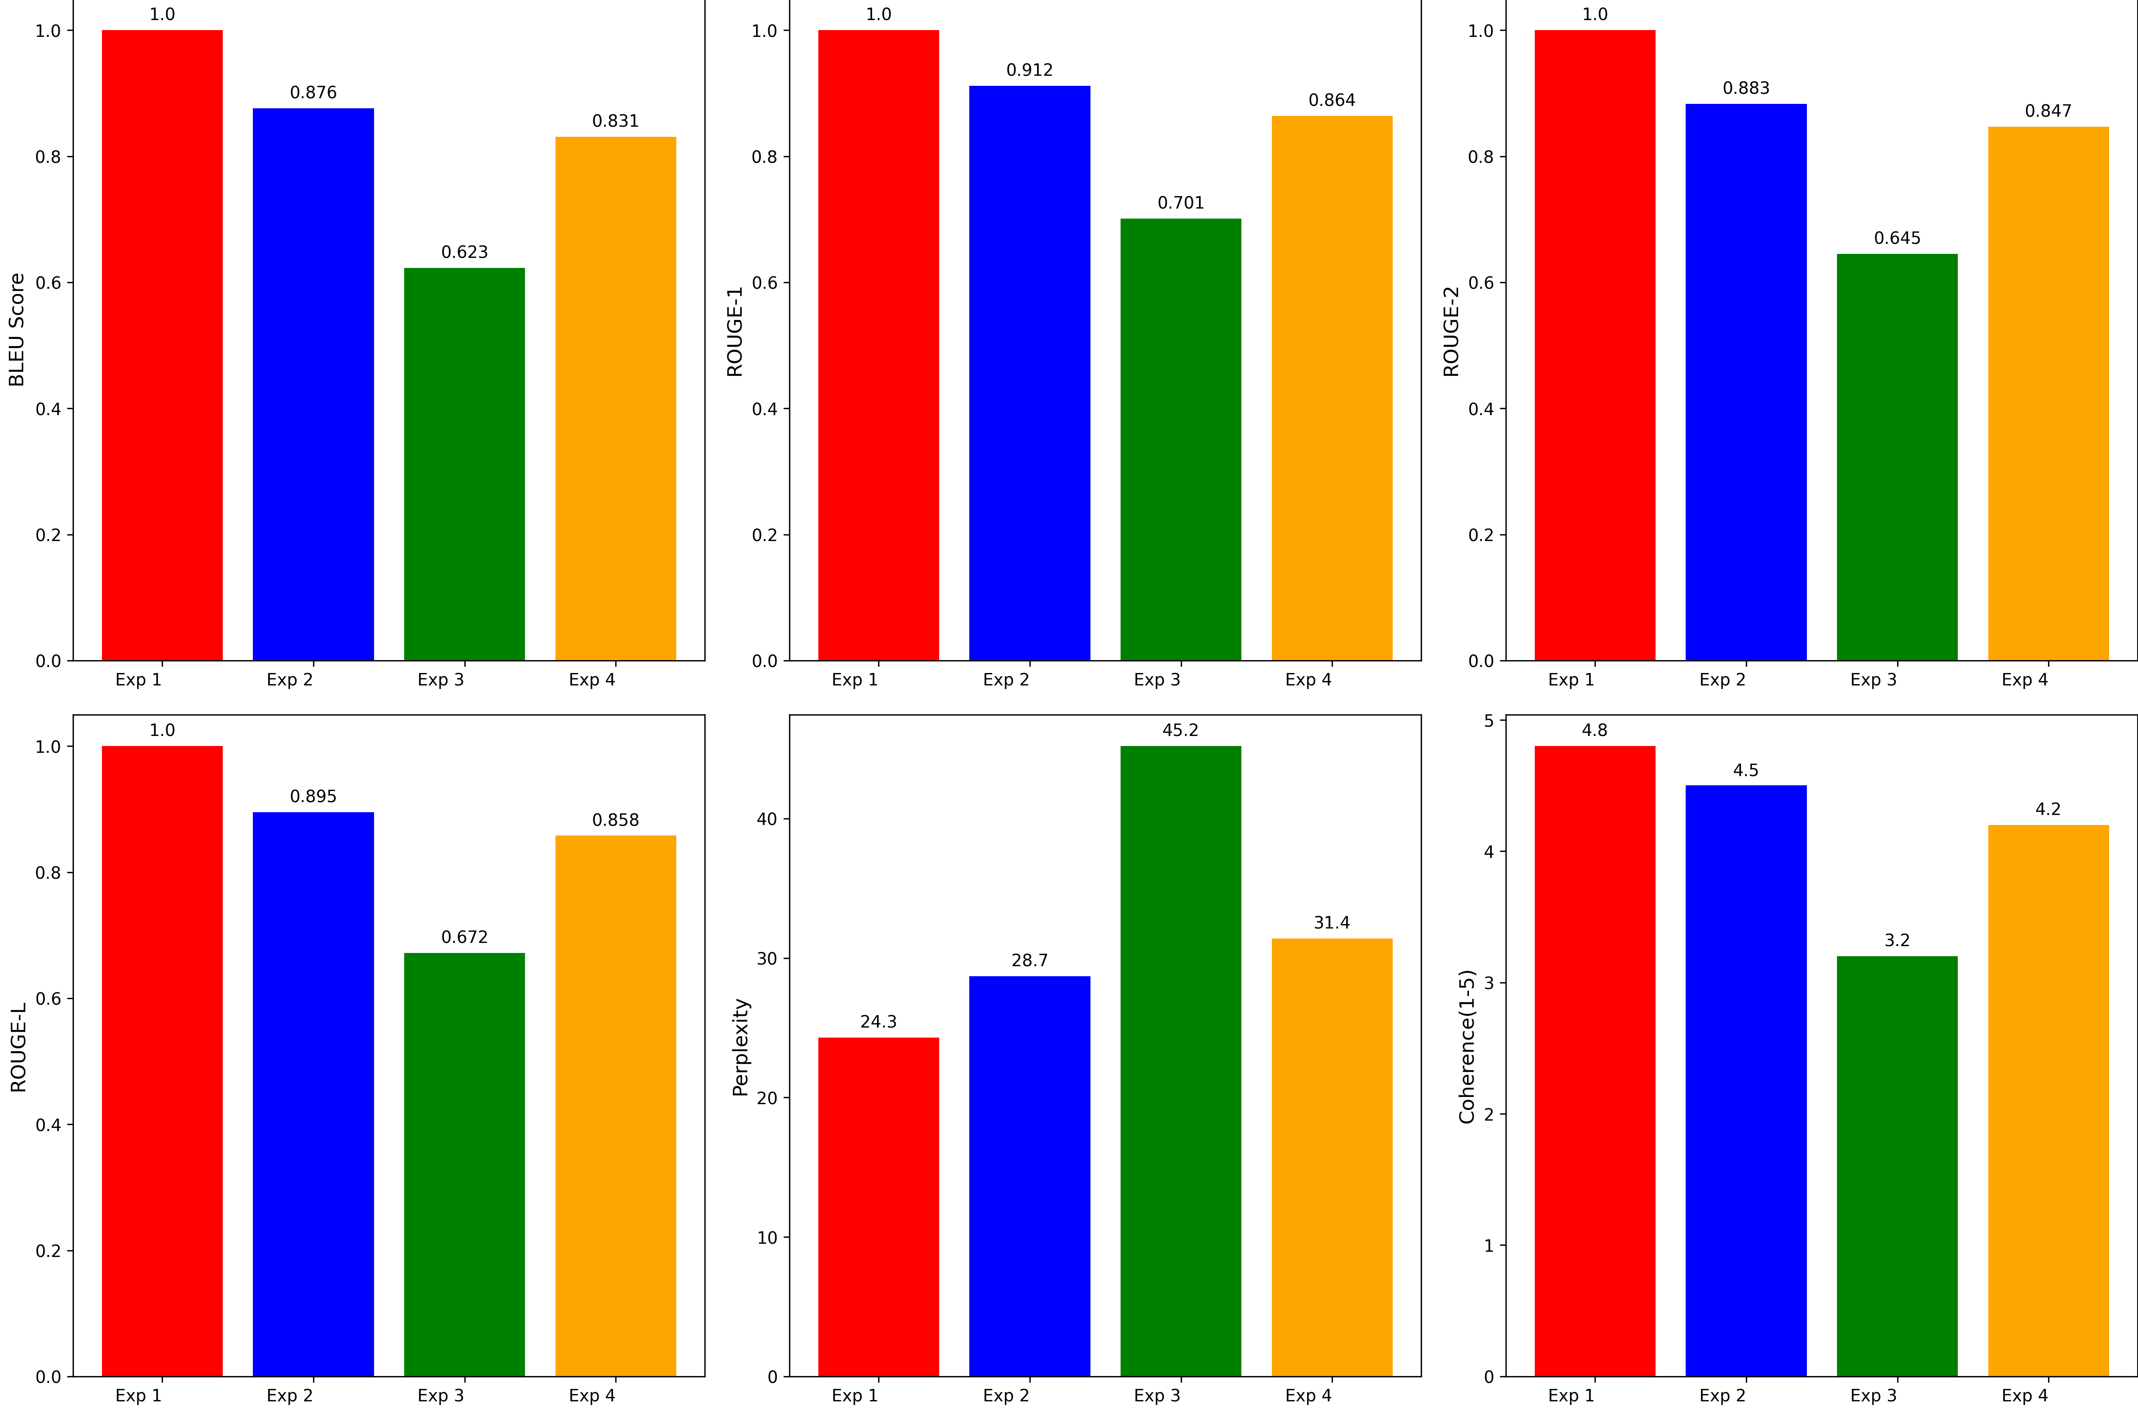
Results and Evaluation : Utility and Quality Preservation
Experiment Conditions | BLEU Score | ROUGE-1 | Coherence(1-5) | Outcome
Exp 1: Real Names (Baseline) | 1.000 | 1.000 | 4.8 | PII entities reappearing verbatim in model outputs
Exp 2: Fake Names Replacement | 0.876 | 0.912 | 4.5 | Maintains 87.6% of the baseline quality
Exp 3: XXXX Masking | 0.623 | 0.701 | 3.2 | Most significant decline in linguistic quality
Exp 4: LLM-based PII Removal(ollMA) | 0.831 | 0.864 | 4.2 | Balanced performance, retaining approximately 83.1% of linguistic quality compared to the baseline
Notes:
This slide captures the Utility and Quality preservation for various experiments conducted.
As you can see from this table and graphs, simple masking performed poorly because the aggressive redaction disrupted the contextual cues essential for the LLM's reasoning.
Conversely, the local LLM-based method achieved a balanced performance, retaining high linguistic quality (BLEU 0.831) and coherence (4.2 out of 5) it is because of LLM adaptive rewriting ensured semantic consistency. Also from last slide LLM based showed greatest privacy after Masking.

Slide 12
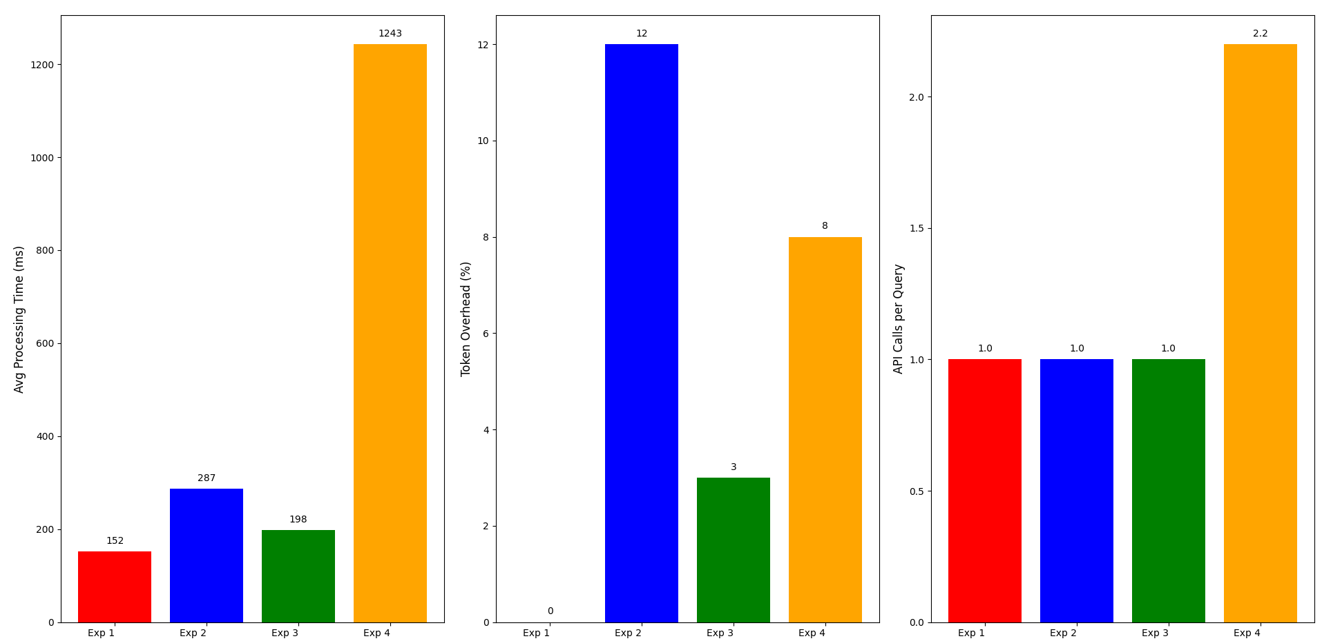
Results and Evaluation : Efficiency Trade-offs
Experiment Conditions | Avg Processing Time (ms) | Token Overhead | API Calls per Query | Outcome
Exp 1: Real Names (Baseline) | 152 | 0% | 1.0 | Acts as a Baseline
Exp 2: Fake Names Replacement | 287 | +12% | 1.0 | Moderate computational overhead (approximately 89% increase)
Exp 3: XXXX Masking | 198 | +3% | 1.0 | Lowest computational burden, only a 30% increase in average processing time compared to the baseline
Exp 4: LLM-based PII Removal(ollMA) | 1,243 | +8% | 2.2 | Highest latency, with an average 718% increase in processing time relative to the baseline
Notes:
This slide discusses the performance for various experiments conducted.
The computational analysis highlights the core trade-off. Simple Faking is very fast (287ms). However, the LLM-based PII Removal imposed the highest latency (1,243ms), a significant increase over the baseline.
This increase is attributed to the computational complexity of semantic rewriting and the dual model calls required. Crucially, this cost is justified in high-stakes domains where privacy guarantees and contextual fidelity outweigh strict real-time latency constraints, making it ideal for batch processing or high-privacy applications

Slide 13

Conclusion, Impact, and Reflection
Method | Privacy Level | Utility Retention | Computational Cost | Recommended Use
XXXX Masking | ★★★★★ | ★★☆☆☆ | ★★★★☆ | High-security / strict compliance
Fake Names Replacement | ★★★☆☆ | ★★★★☆ | ★★☆☆☆ | General inquiries / low risk
LLM-based PII Removal | ★★★★☆ | ★★★★☆ | ★☆☆☆☆ | Balanced / sensitive domains
Conclusion: CSM, A Privacy-preserving Framework provides techniques to preserve PII data at client end and various methods to balance performance and privacy for different use cases.
Based on balancing these trade-offs, the CSM framework recommends LLM-based PII Removal as it provides high
utility retention and strong privacy protection, making it the superior choice for sensitive domains where accuracy
and compliance are paramount .
Notes:
As you can see from the table, you can go for masking where Privacy requirement is non-negotiable but utility can be compromised. Fake Names provide middle level privacy with high utility retention and can be used in general purpose chatbots. Where as in sensitive domains like healthcare, finance Privacy is non-negotiable but utility is requirements are also high so someone can choose for Local LLM based PII removal.
In conclusion, CSM provides technique for PII data removal as well as various methods to chose from to balance performance and privacy.
Our final recommendation, based on balancing these trade-offs, is LLM-based PII Removal. It provides high utility retention and strong privacy protection, making it the superior choice for sensitive domains where accuracy and compliance are paramount.

Slide 14
Contribution and Research Impact
Contribution: Developed a structured evaluation framework for privacy transformations.
Empirically assessed masking, faking, and LLM-based redaction, Validated client-side NER feasibility for real-time chat .
Impact: Enhances security and trust of LLM chatbots in financial/healthcare/education. Provides a practical, efficient, and secure framework.
Notes:
This research makes several key contributions: we developed a structured, modular evaluation framework; provided a quantitative comparative analysis of anonymization methods; and demonstrated the practical feasibility of using client-side NER for real-time privacy handling.
The practical impact is significant: the proposed architecture enhances the security and trust of LLM chatbots in regulated industries like finance and healthcare. This contribution moves us closer to enabling safer and more responsible use of AI in sensitive domains

Slide 15
Reflection and Future Directions
Reflection: Student Development: Consistent and comprehensive reflection on balancing the privacy-utility trade-off.
Gained expertise in complex hybrid architectures (NER + Local LLM + Remote LLM).
Ensured methodological rigor in multi-metric evaluation .
Future Work: Integrating Differential Privacy or Federated Learning for stronger guarantees. Expanding to Cross-Lingual and Multimodal inputs. Conducting Human Evaluation Studies for perceived trustworthiness.
This research reaffirms that privacy-preserving LLM inference is technically feasible and essential for responsible AI adoption.
Notes:
My development throughout this thesis was substantial, particularly in navigating the persistent challenge of the privacy-utility trade-off. This required consistent and comprehensive reflection on architectural choices, such as using lightweight, client-side tools like spaCy and Ollama to guarantee compliance and efficiency.
For future work, I recommend integrating mathematically provable guarantees, such as Differential Privacy, and expanding the framework to support multiple languages. We must also complement automated metrics with human evaluation to fully assess perceived trustworthiness.
This research reaffirms that privacy-preserving LLM inference is technically feasible and essential for responsible AI adoption.

